Slide 1

Some ideas about
how to compare distributions

Slide 2


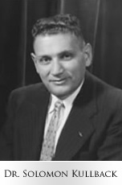
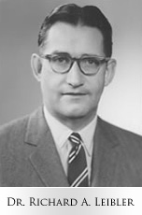
1907-1994
1914-2003

Slide 3
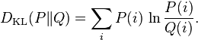
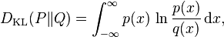
Kullback-Leibler divergence (1951):
entropy
or
cross entropy
Lots of nice properties:
since ln (x) ≤ x - 1
• Invariance under parameter changes:

Slide 4
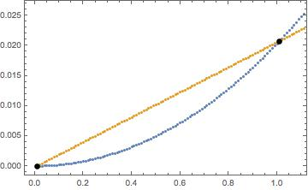
The KL divergence is convex:
Consider D_{KL}(p, [1-x]p+xq) for 0 < x < 1. Convexity says that this divergence is always less than the linear interpolation for any choice of the distributions p and q.
Convexity ensures that Jensen’s inequality, Hölder’s inequality, and
the arithmetic-geometric mean inequality all hold. Check this out on
the Wikipedia.

Slide 5
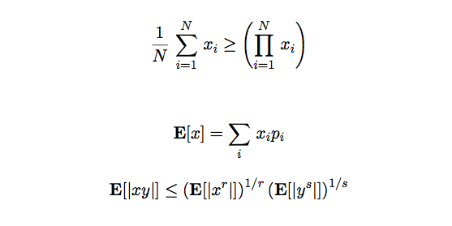
arith.-geom.
Hölder

Slide 6
Some ideas about
how to compare distributions

Slide 7
Some ideas about
how to compare distributions

Slide 8
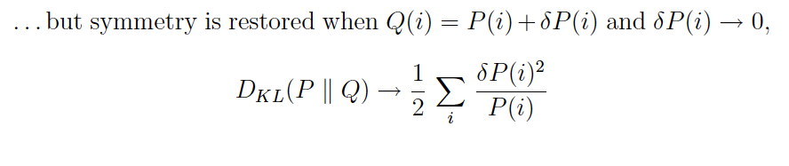
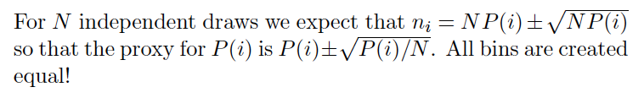
• It is additive for independent distributions:
If P(x,y) = P₁(x)P₂(y) and Q(x,y)=Q₁(x)Q ₂(y),
The KL divergence is not a metric since

Slide 9
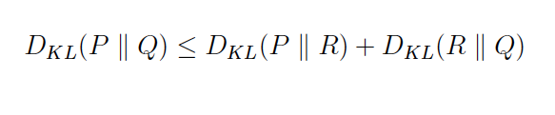
•
KL divergence also fails to satisfy the triangle inequality
•
So, the KL divergence is sometimes called a `premetric’.
In spite of its formal shortcoming, the KL divergence can
be an extremely useful tool for comparing distributions.

Slide 10
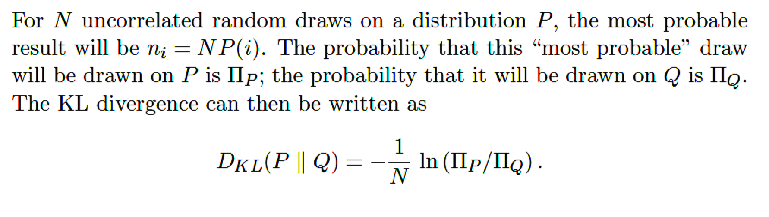
A simple physical interpretation:

Slide 11
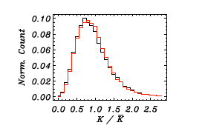
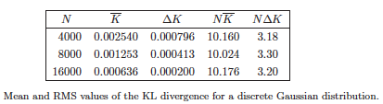
Often, we are interested in comparing P with the distribution
obtained from result of N random draws on P. How do the
statistical properties of D_{KL} depend on N?
If the data is sorted into N_{bin} bins, we should expect that
D_{KL} will be of order N_{bin}/N.

Slide 12
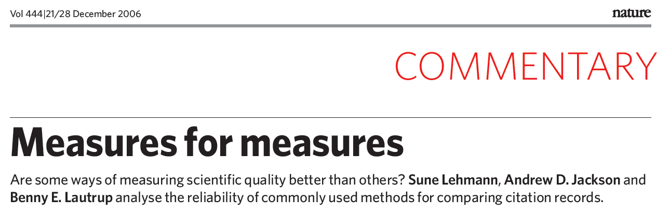
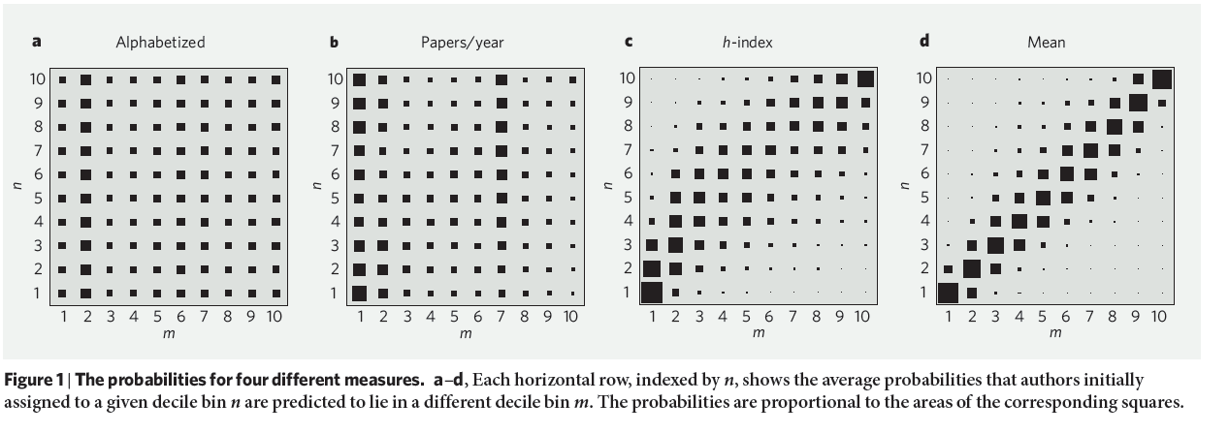

Slide 13

So, what else can spies do for us?

Slide 14
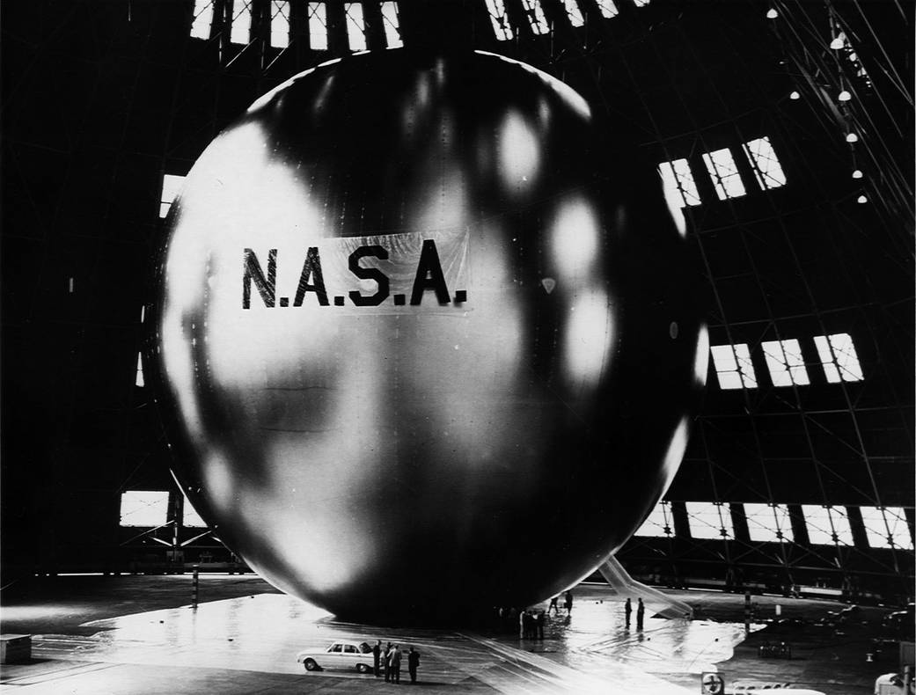
NASA’s Echo I and Echo II “satelloon” program (1960-69)

Slide 15
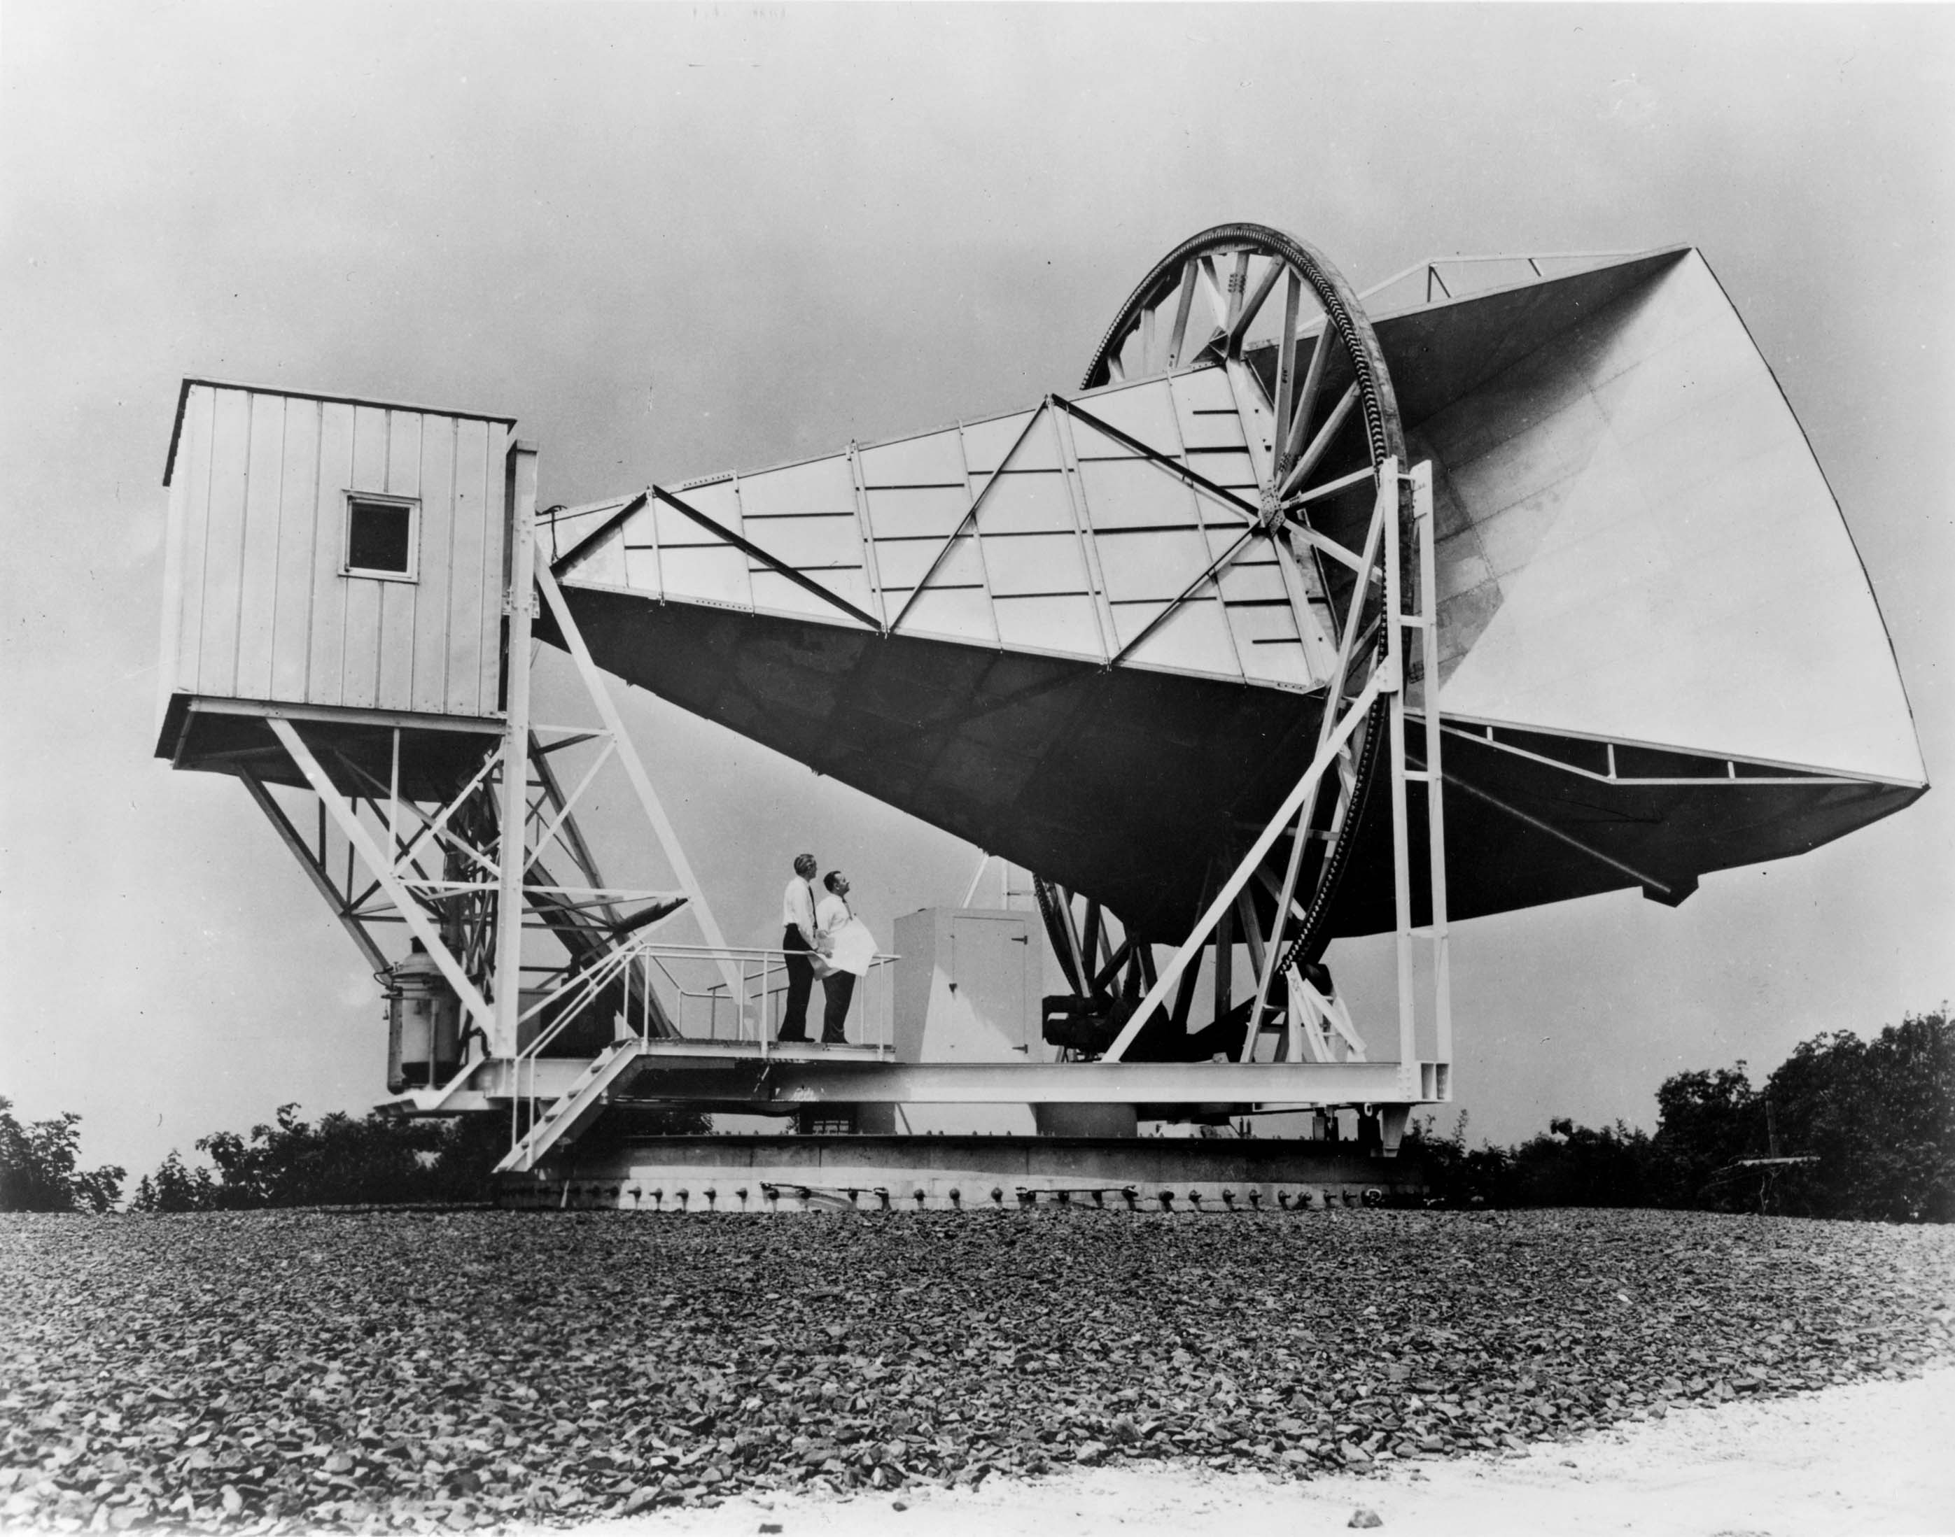
The Holmdel Horn

Slide 16
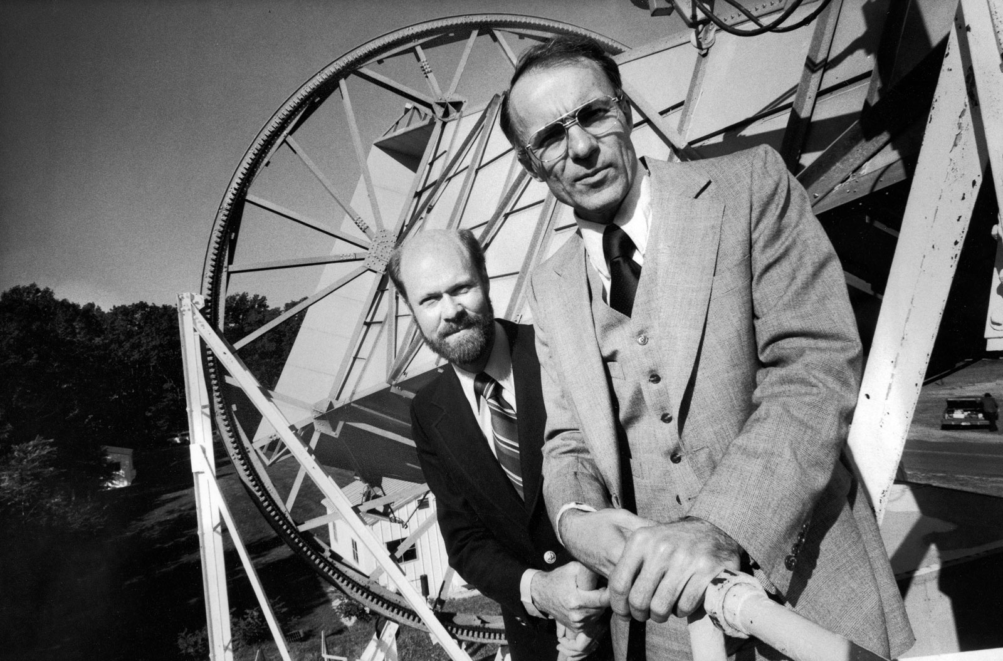
Arno Penzias and Robert Wilson

Slide 17
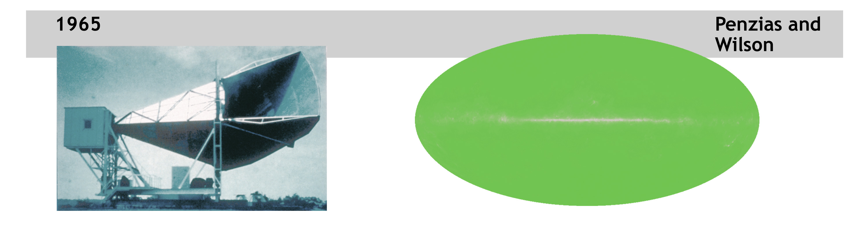
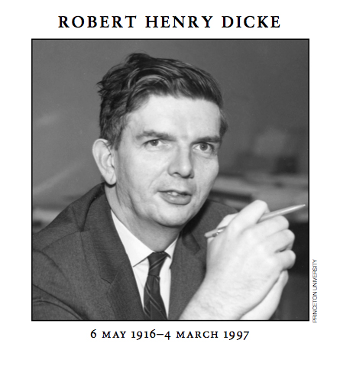
Completely uniform microwave background at 300 GHz!
Galactic plane
Princeton to the rescue … In early 1960s Dicke, Zeldovich and Igor Novikov independently suggested such radiation as a remnant of the Big Bang some 13.8 billion years ago!

Slide 18
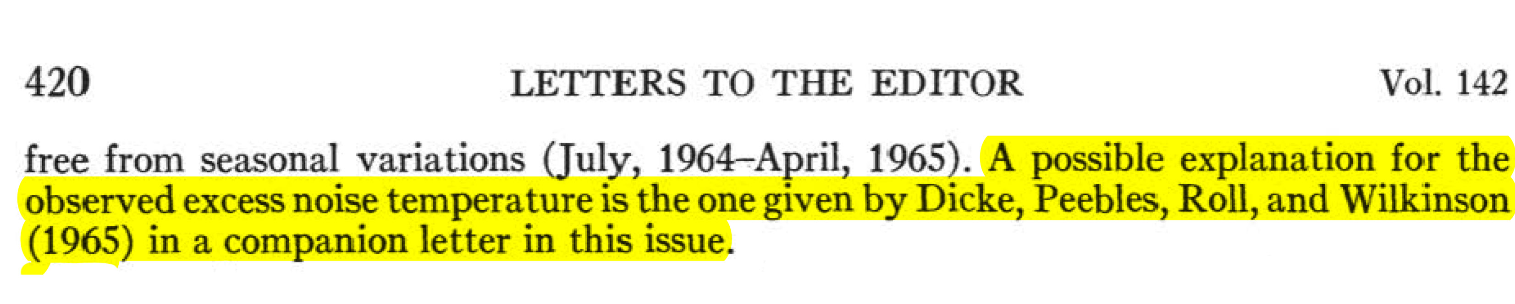
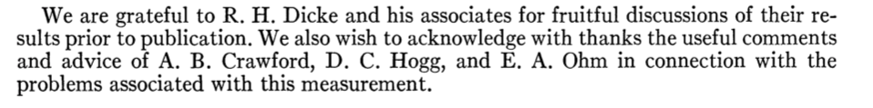
Penizias and Wilson knew nothing about CMB:
They didn’t know how to say “thank you” either:

Slide 19
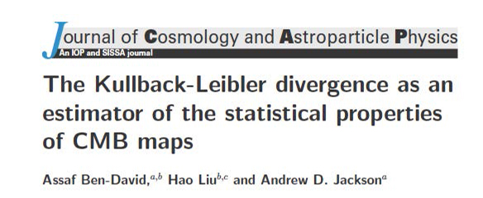
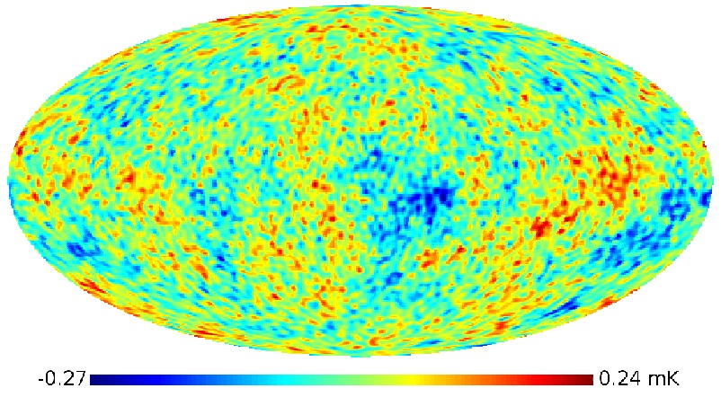
SMICA map of CMB temperature fluctuations:
and
= Pavel Naselsky
Is the data Gaussian?
KL says that it is.

Slide 20
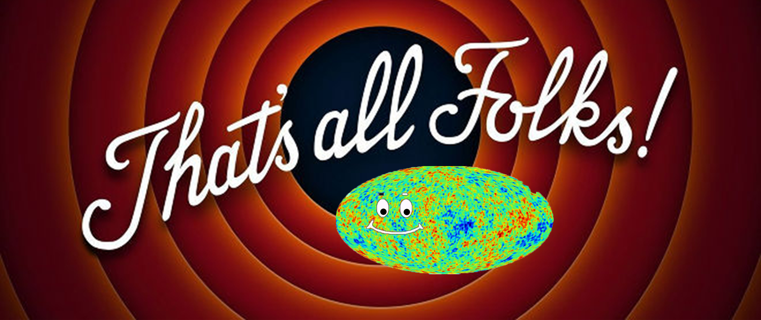
Part 1

Slide 21
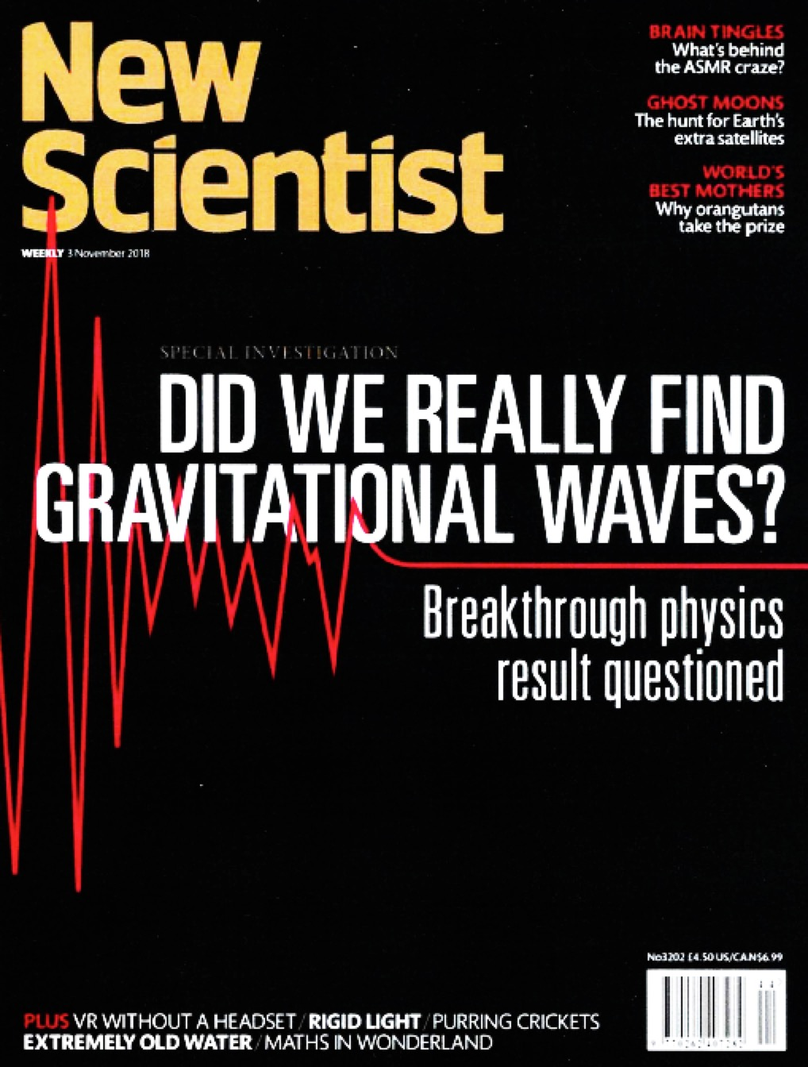

Slide 22
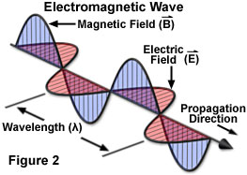
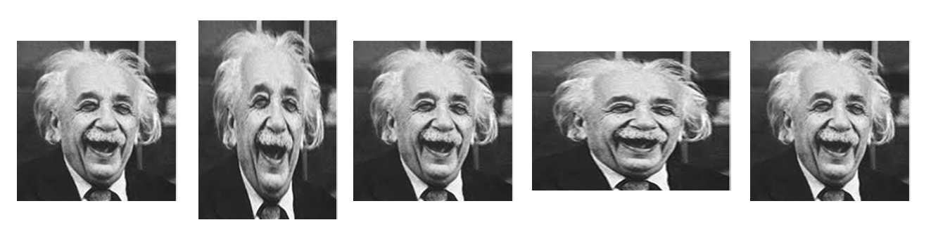
Gravitational Waves:
Accelerating charges radiate transverse
electromagnetic waves.
Accelerating masses radiate gravitational waves that are also
transverse. A gravitational wave in direction z will alternately squeeze
and stretch space in the perpendicular directions x and y.
Notes:
Suggested by Oliver Heaviside in 1893 (analogy with EM), and Henri Poincare in 1905 (special relativity), and Einstein in 1916.

Slide 23
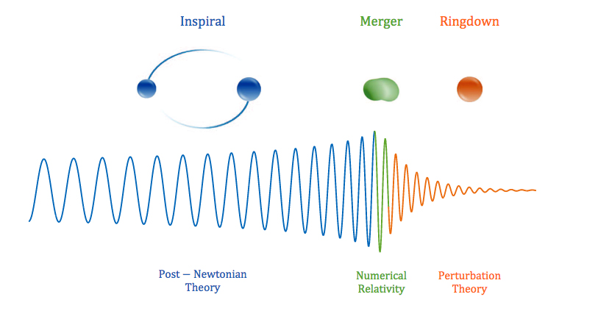
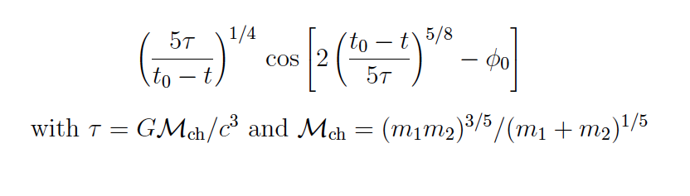
(This wave form is characteristic for any “catastrophic” event.)

Slide 24
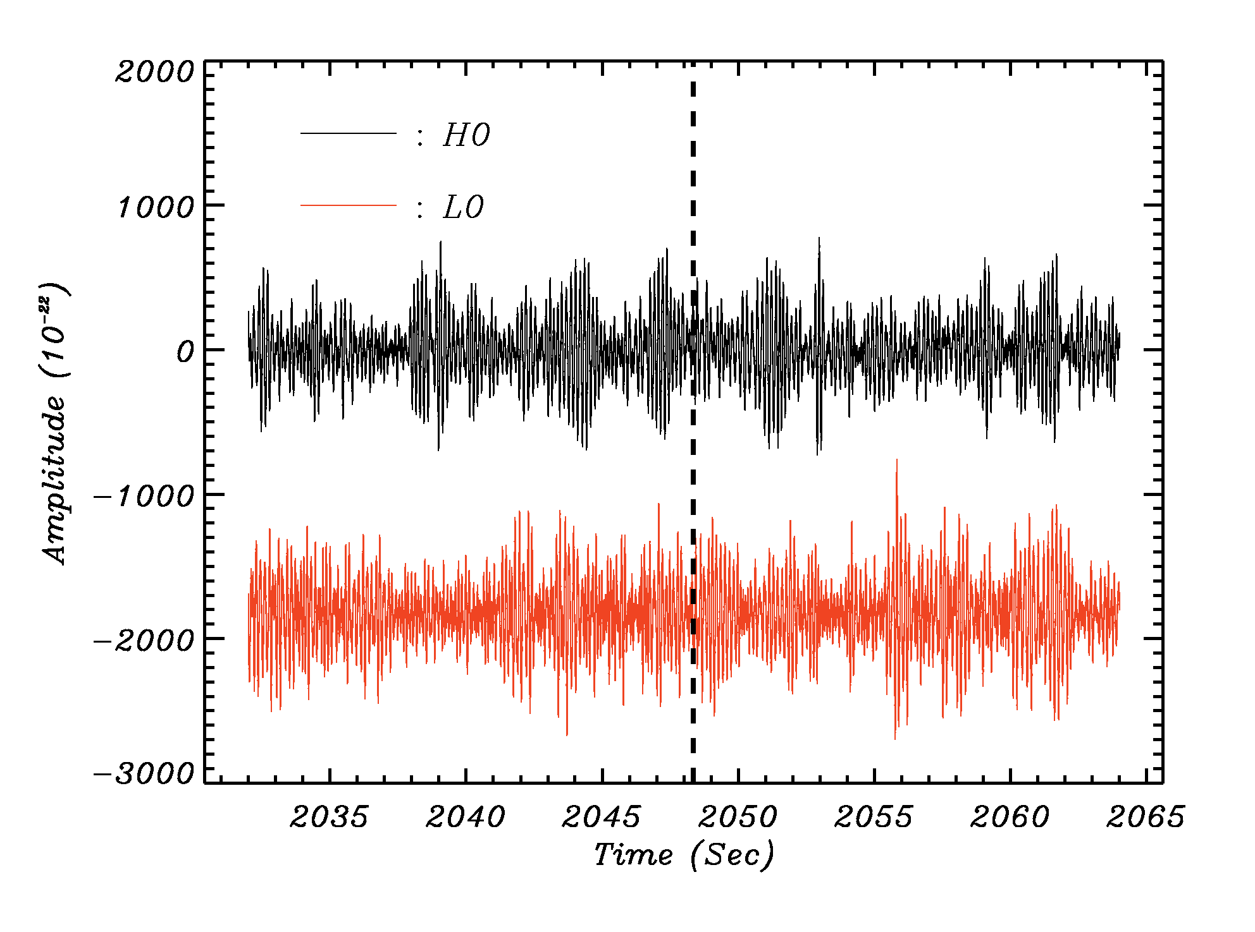
The initial 32 s time records for Hanford and Livingston
See the event?
See the scale!
“Noise” is roughly 300 times larger than “signal”. Cleaning is required! Unfortunately, the available data has been “pre-cleaned” with unknown consequences.

Slide 25
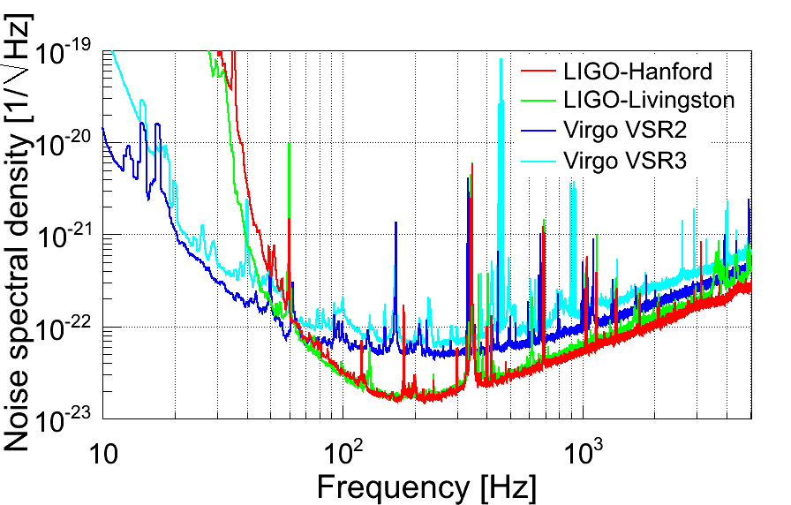
High sensitivity = Noise! This includes narrow resonances
(e.g., calibration signals and 60 Hz noise and harmonics).
Data cleaning is essential.

Slide 26
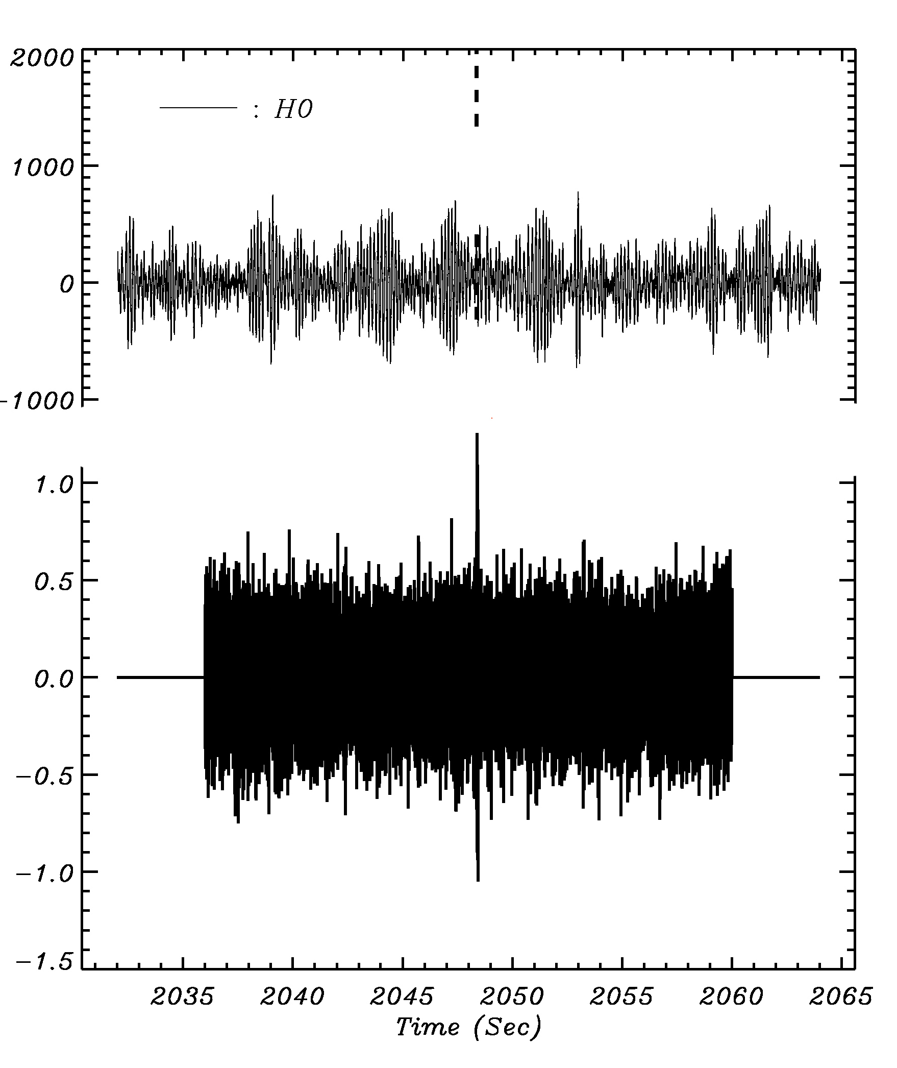
LIGO GW150914
The simplest possible cleaning is sufficient to reveal the signal!

Slide 27
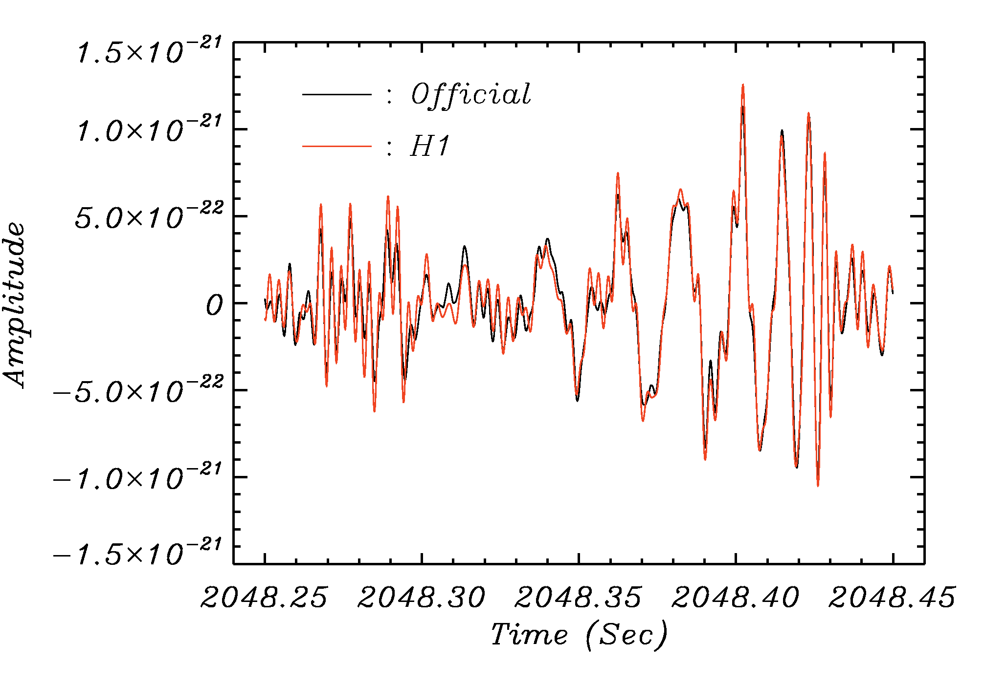
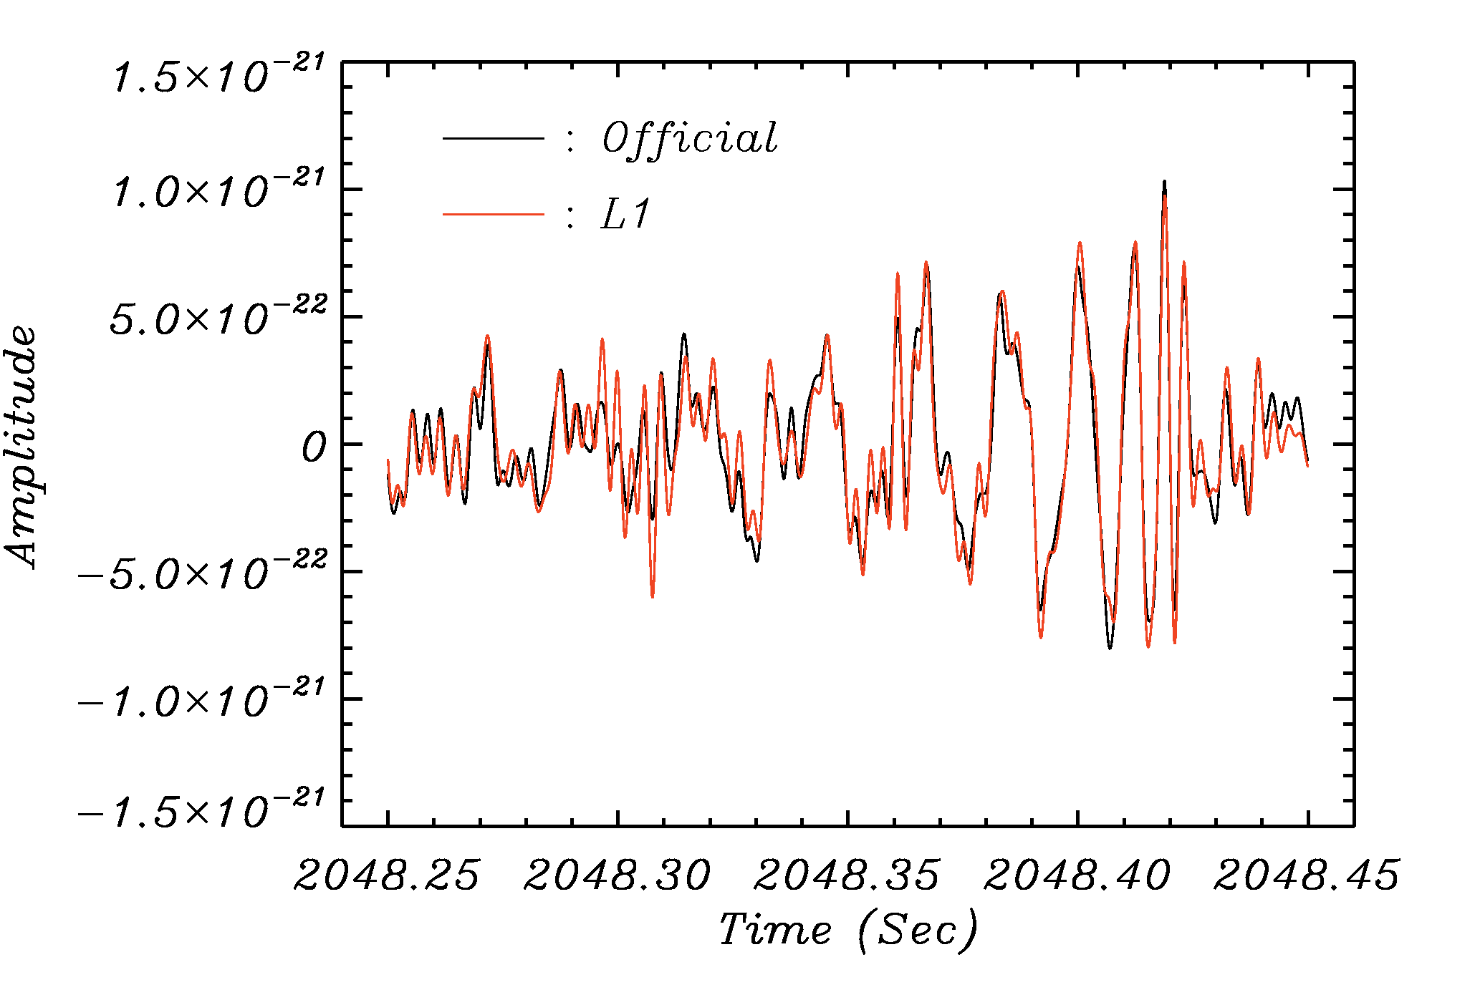
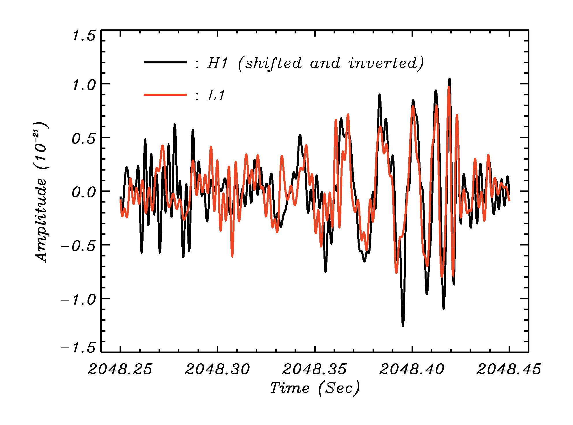
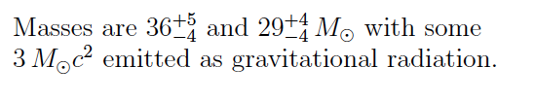
The signals …
C_{H} = 0.97
C_{L} = 0.95
C_{HL} = 0.67 – 0.79

Slide 28
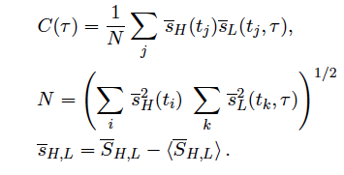
Pearson cross-correlation coefficient:
Here, τis the time shift between the two detectors.

Slide 29
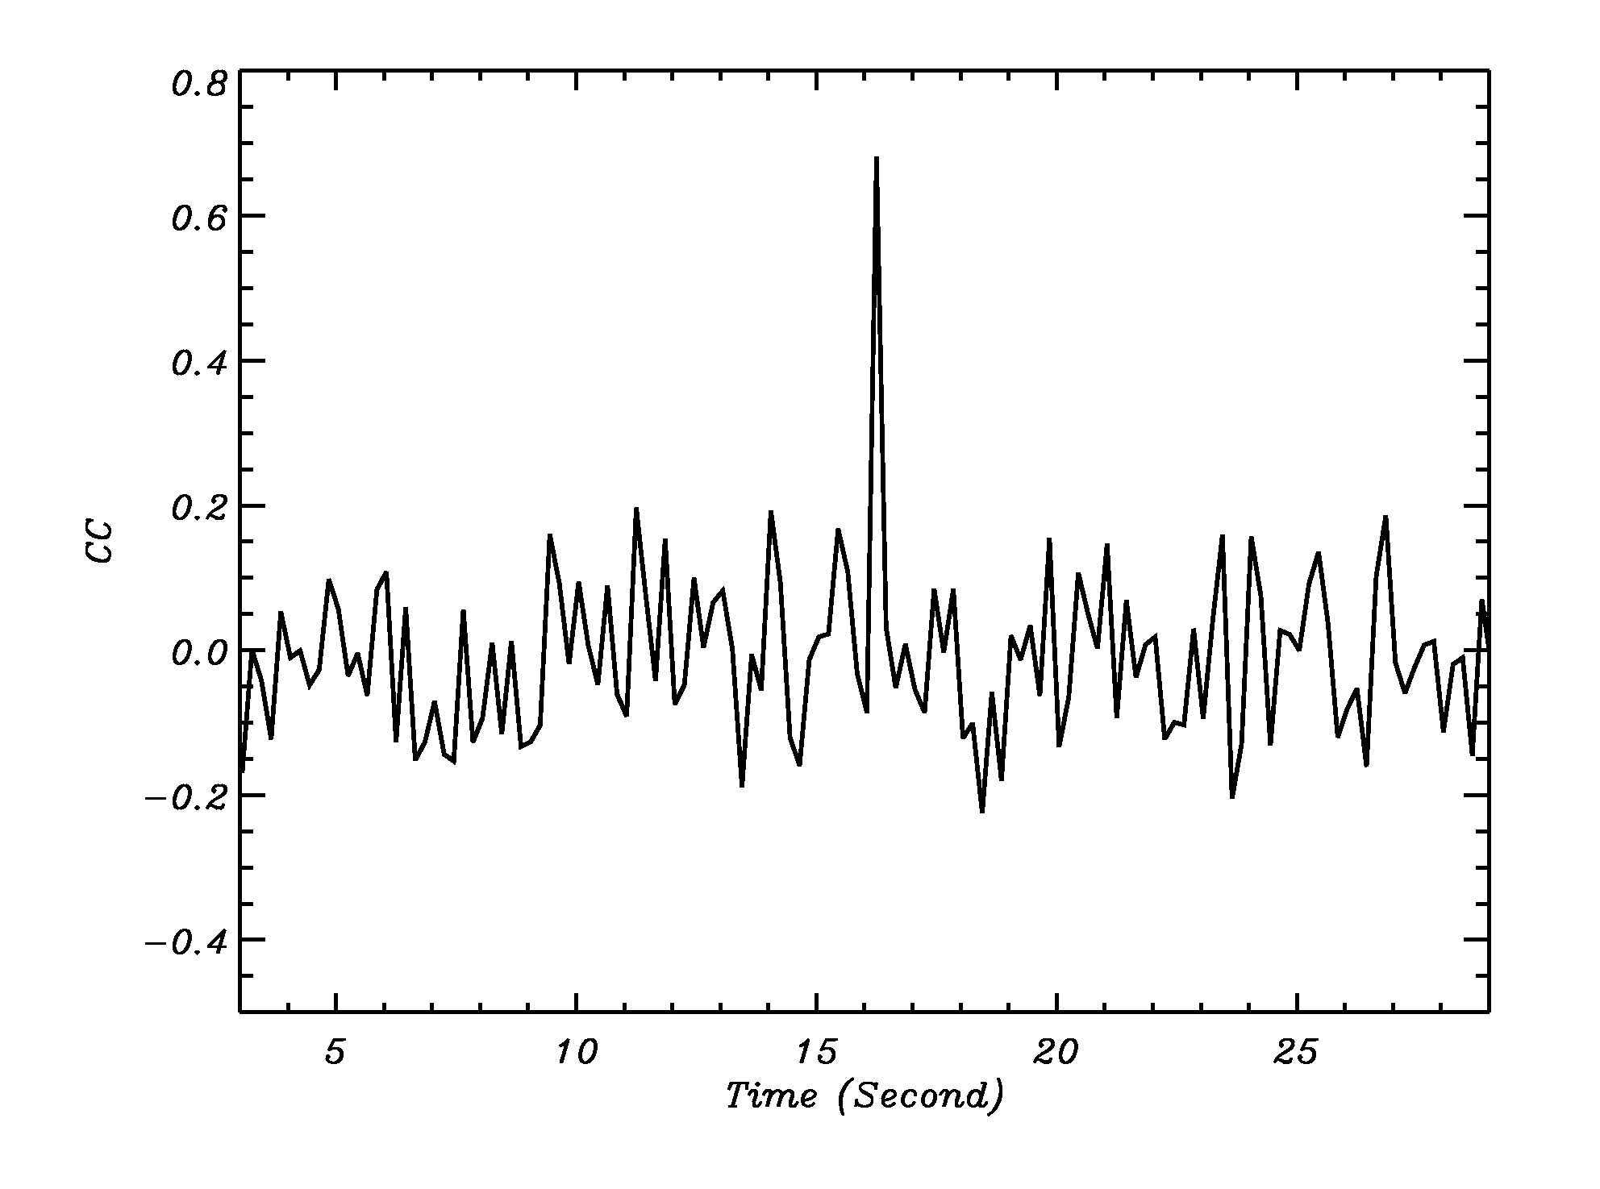
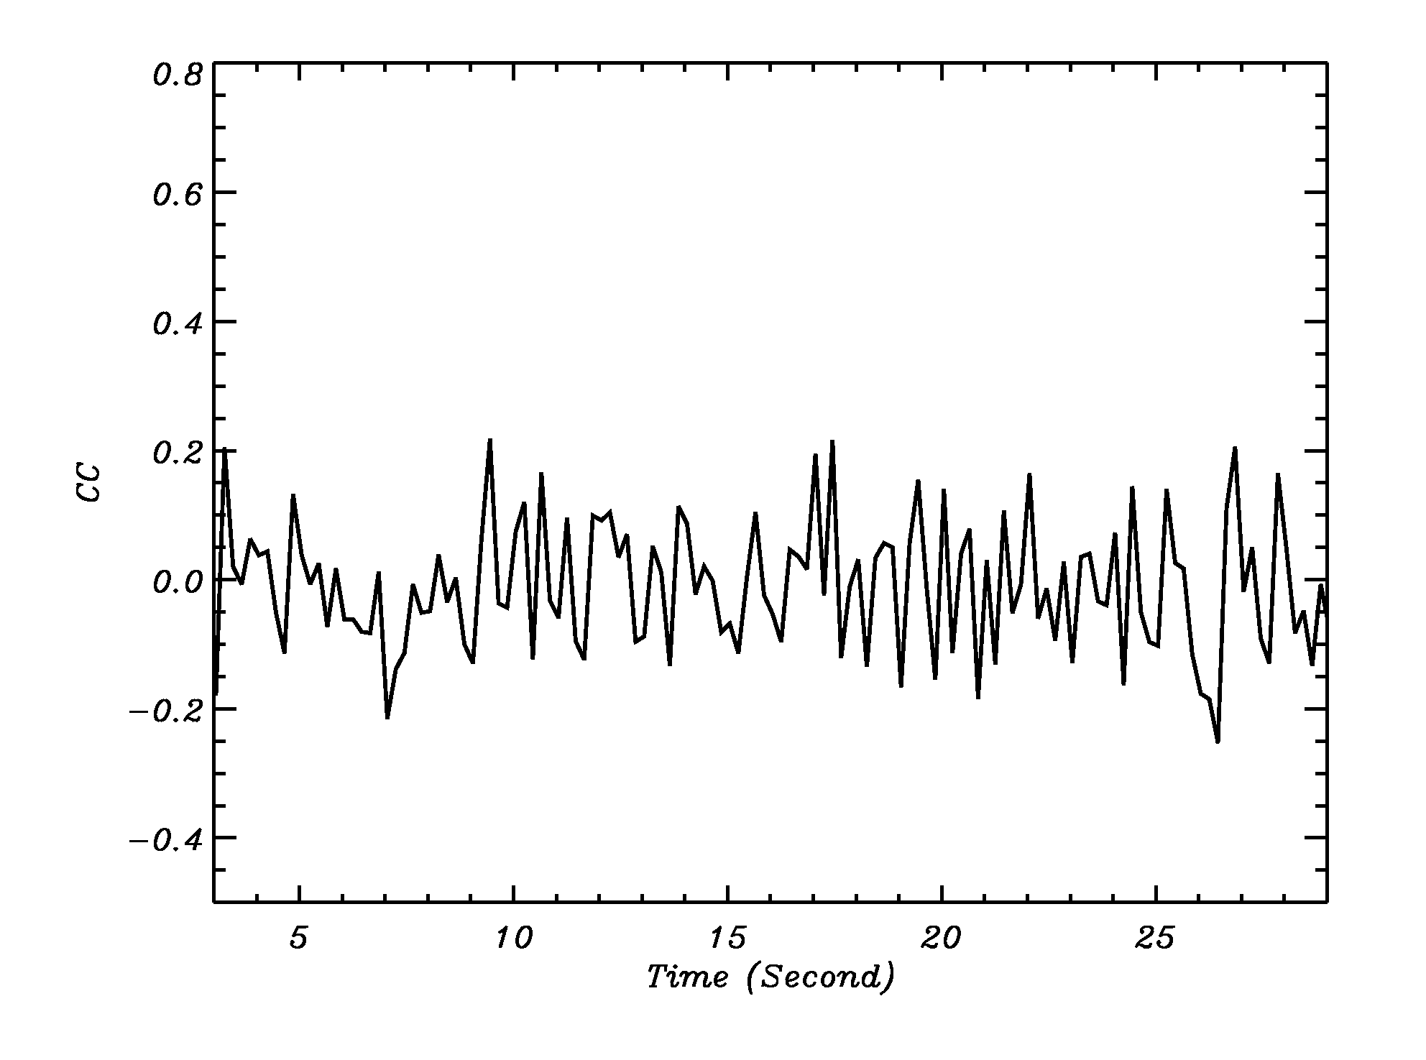
τ = 6.9 ms
τ
= 6.9 ± 0.4 ms
τ= 4 ms
C(τ) makes it is simple to determine
the time delay between H and L.

Slide 30
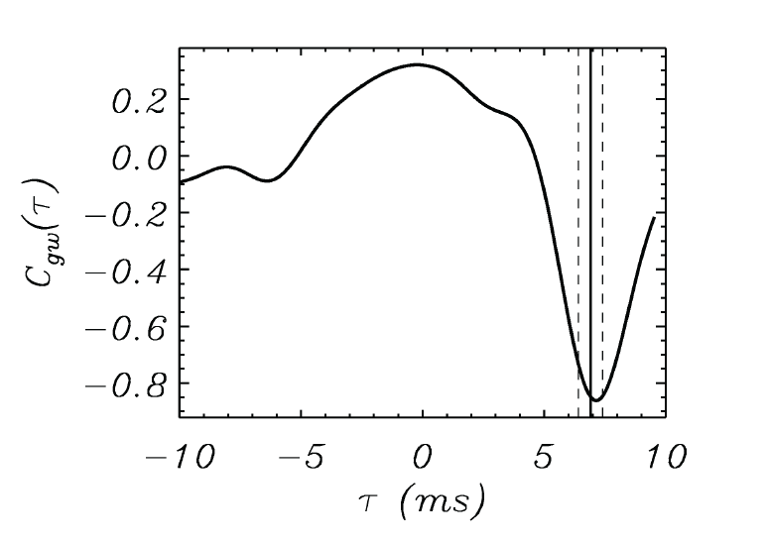
The cross-correlator between Hanford and Livingston signals
as a function of the time delay.
“confirmation” of the event

Slide 31
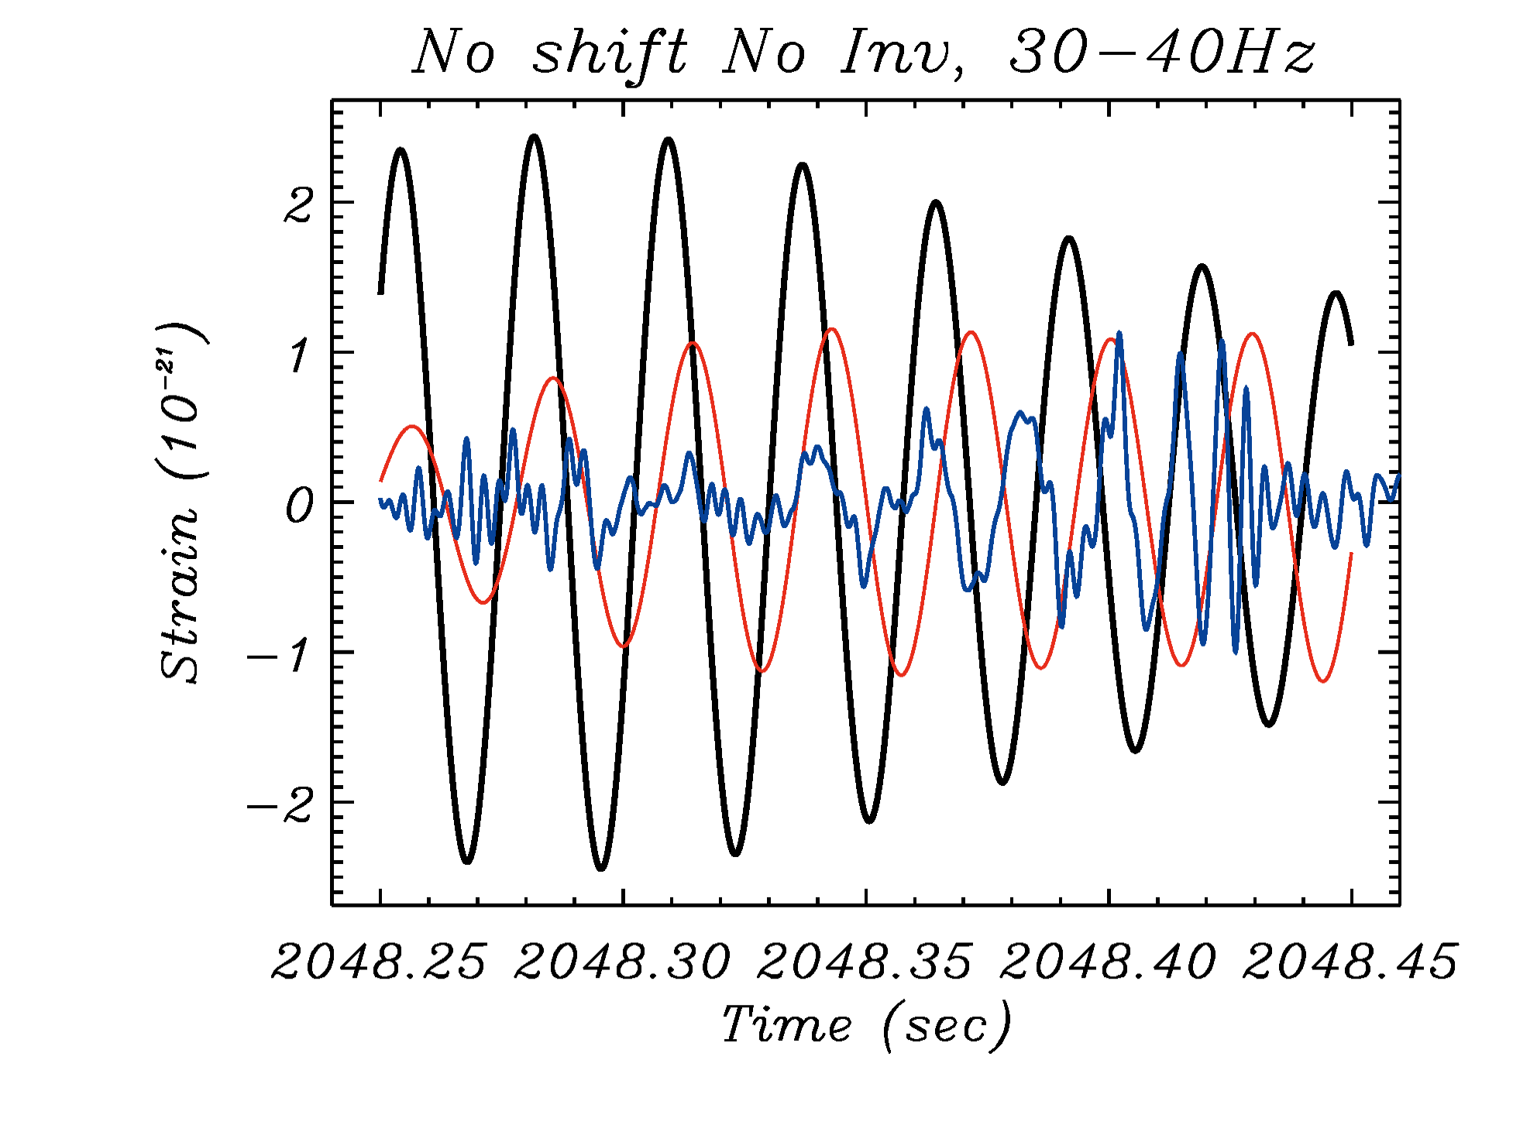
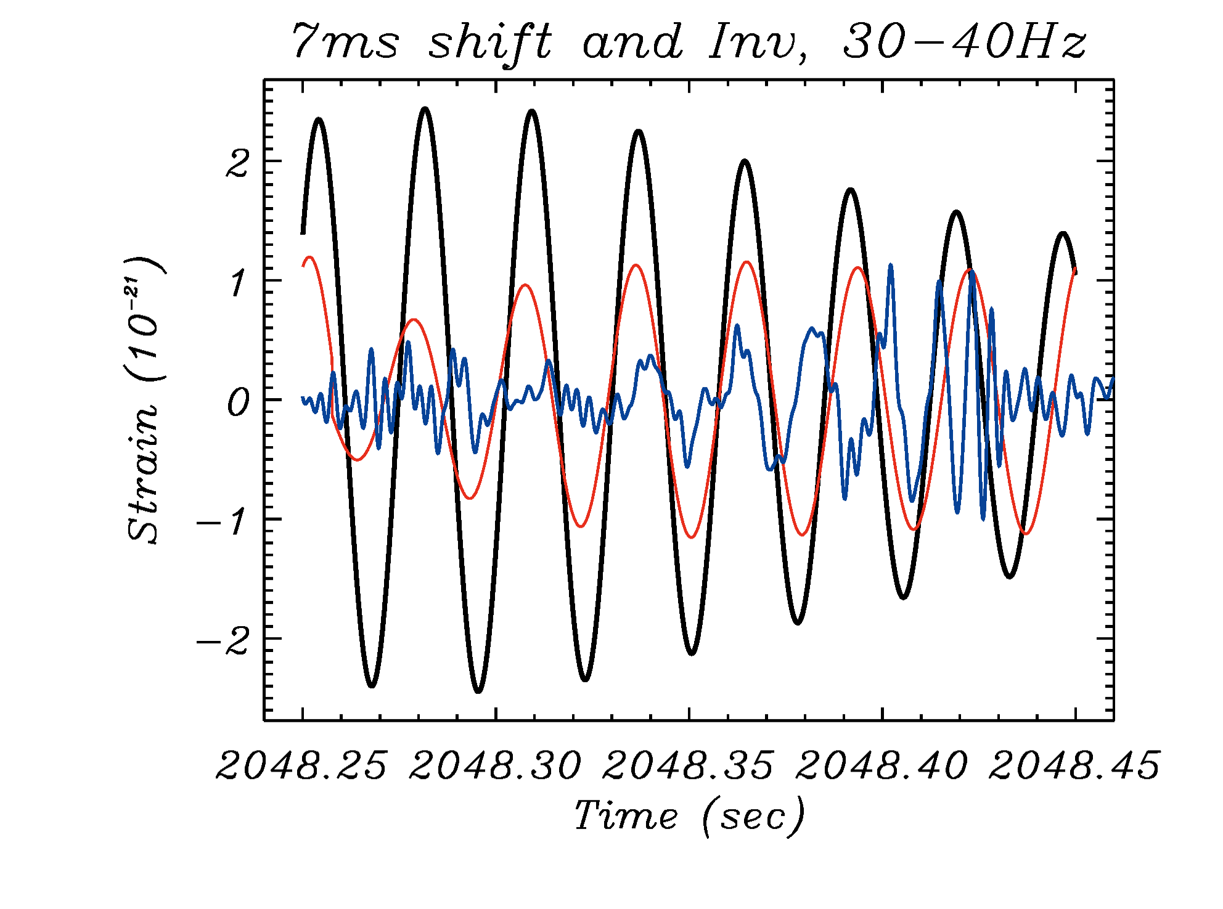
Hanford has calibration lines at 35.9 and 36.7 Hz; Livingston
has similar lines at 34.7 and 35.3 Hz.
The same 7 ms shift brings these lines in phase.

Slide 32
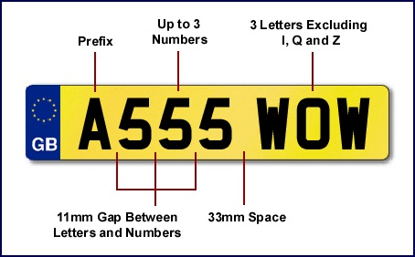

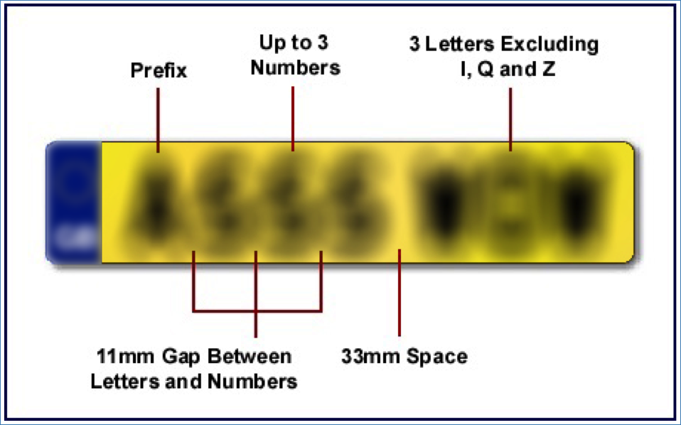
Police routinely use template analysis because they know exactly
what to look for.

Slide 33
But a French license plate would cause problems.
We must know the probability that an observed event
is a gravitational wave and that it is due to black hole merger.

Slide 34
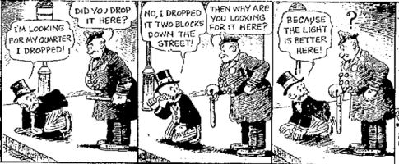

Slide 35
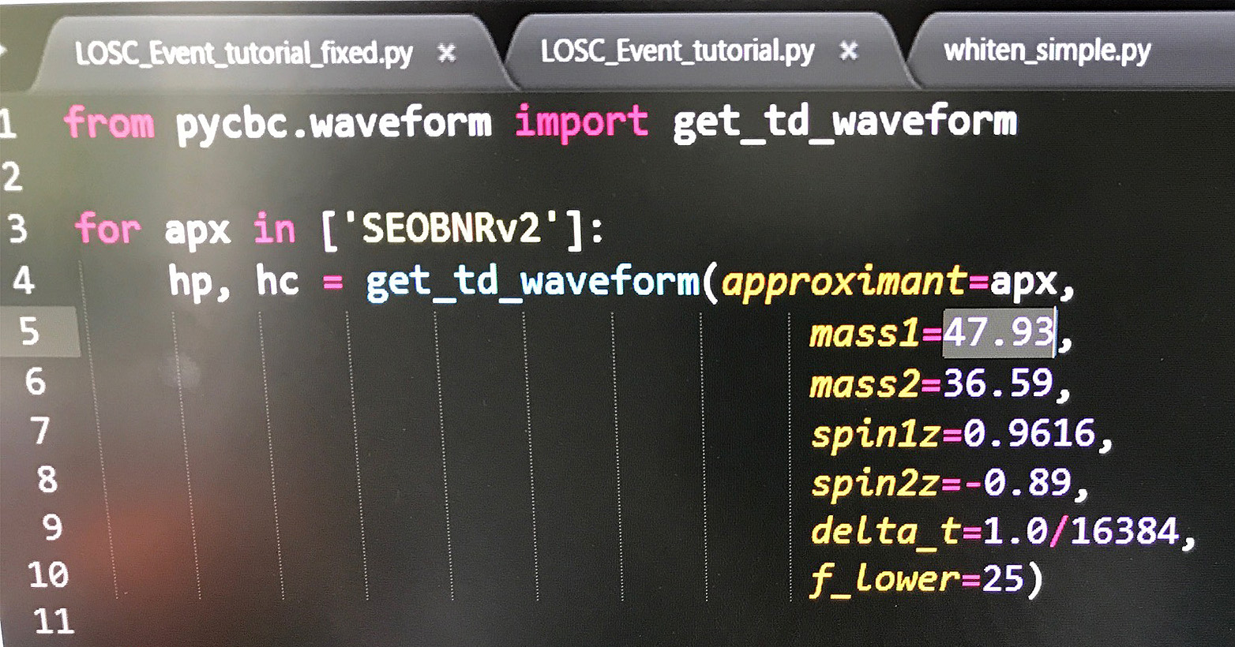
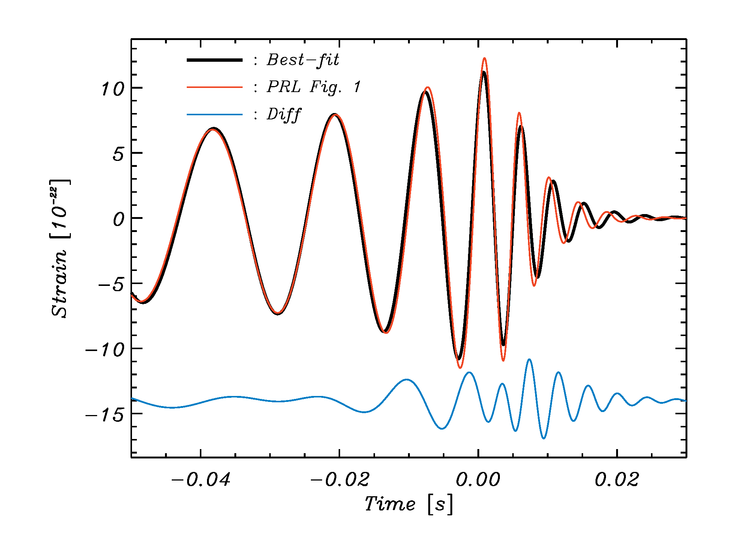
The Secret Template
There is an enormous degeneracy in
the templates that makes it very hard
(impossible) to determine masses with
accuracy!
The use of the “secret template” does
not change our results! LIGO knows
this but will not admit it.

Slide 36
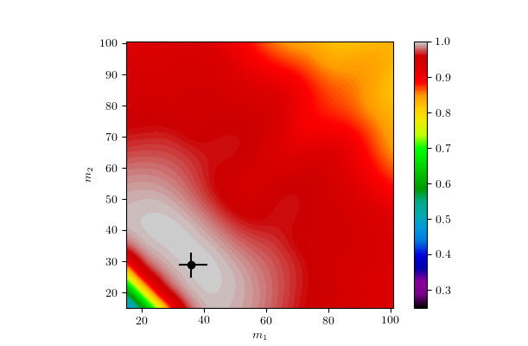
LIGO’s masses are completely uncertain!

Slide 37
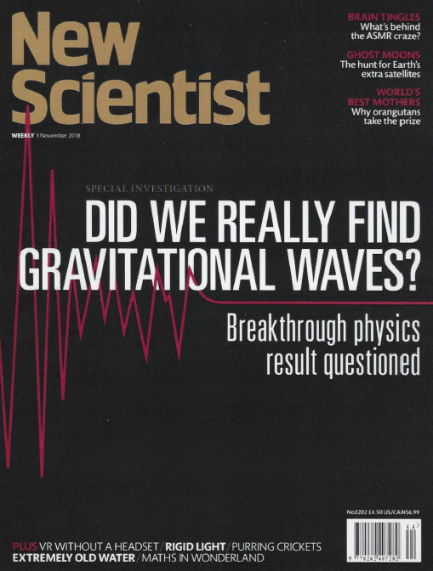
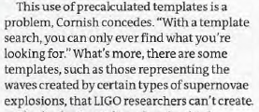


Slide 38


Slide 39



Planck × 2
Any image can be written as
But what do we get if we mix the amplitude from the Planck
satellite image with the phases of the Max Planck image?

Slide 40

Surprisingly, we get Planck himself!
Morphology is largely determined by phases and not amplitudes.
The power spectrum fails to tell the whole story.
Lung-Yih Chiang
http://www.asiaa.sinica.edu.tw/~lychiang/index/node8.html

Slide 41
The unbiased “best common signal”

Slide 42
SNR±1
Maximum likelihood methods are not useful! They cannot determine either the intrinsic features of a binary black hole
system or determine its sky location!

Slide 43

OBSERVATIONS:
By the way, physicists should demand to see uncertainties
and should know how they were calculated!

Slide 44


Slide 45
Part 2

